Slide 1
Chapter 4: Conditionals and control Flow
This chapter will help the reader understand the following concepts:
Relational operators
Logical operators—and, or, not
Operators and vectors
Conditional statements

Slide 2
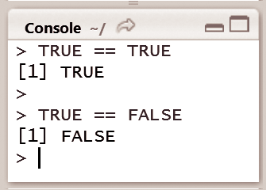
Relational operators
Relational operators are comparators that help us understand how one object relates to another.
For example, to check whether two objects are equal, the double equal operator can be used to check if the logical value TRUE equals the logical value TRUE (TRUE == TRUE) and the result is a logical value
Logical variables can also be used to check the quality of other types, which compares strings and numbers

Slide 3
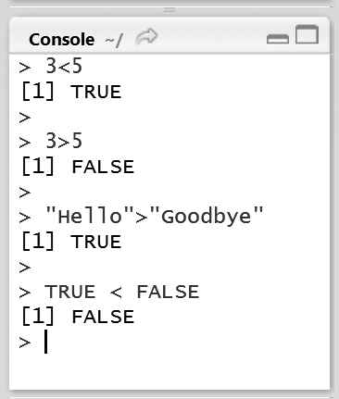
These are the steps needed to be done to check if an object is lesser than or greater than another object.
In the case of numerical values 3 < 5 will evaluate to TRUE and 3 > 5 will evaluate to FALSE.
For character strings and logical values, R uses the alphabetic order to sort character strings
For logical values is TRUE < FALSE evaluates to FALSE, since TRUE corresponds to 1 and FALSE corresponds to 0

Slide 4
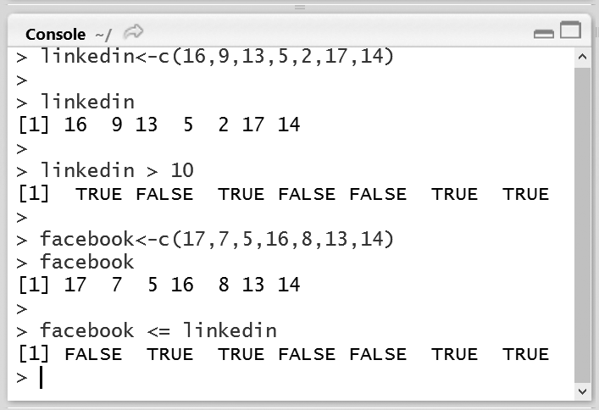
Relational operators and Vectors
Consider a scenario for recording the number of views of a LinkedIn profile per day using the vector linkedin, shown in Fig
For example, to find out on which days the number of views exceeded 10, use the greater than (>) operator,here these elements the result will be TRUE.
Vectors can also be compared with other vectors. A record of the number of facebook user profiles for the previous week is available, which can be saved in another vector called facebook.

Slide 5
logical operators
To change the combined results of comparisons, R uses the logical operators—AND (&), OR (|) and NOT (!).

Slide 6
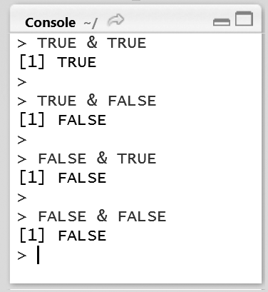
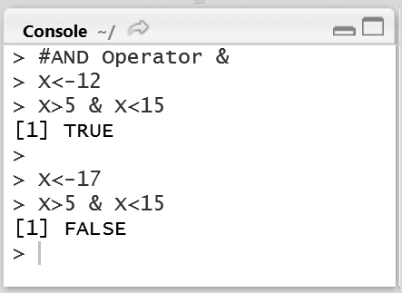
AND operator
The AND operator takes two logical values and returns TRUE only if both these logical values are each TRUE
Instead of using logical values, the results of comparisons can be used

Slide 7
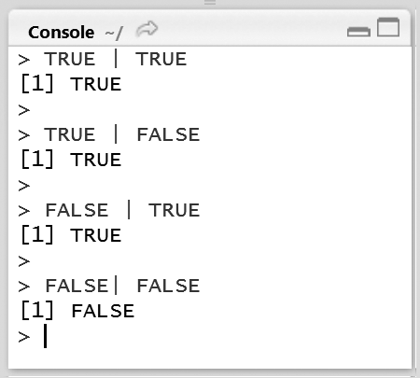
OR operator
The OR operator works similar to the AND operator with a difference that at least one of the logical values should be TRUE for the entire operation to evaluate to TRUE.

Slide 8
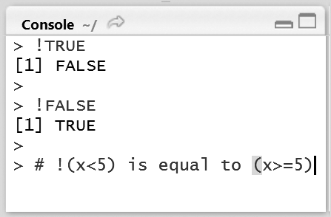
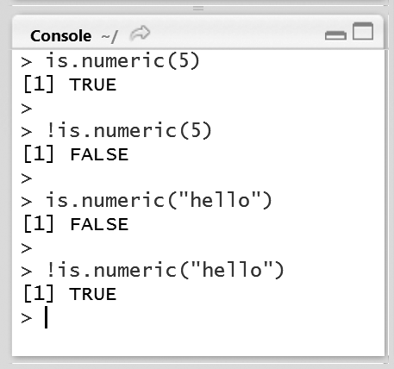
NOT operator
The NOT operator represented by ! simply negates the given logical value

Slide 9
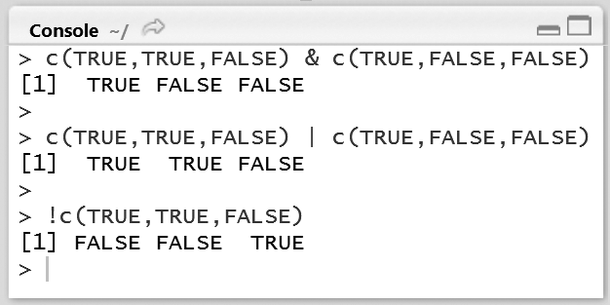
logical operators and Vectors
The working of logical operators with vectors and matrices is similar to that of the relational operators; the operations are performed element-wise.
Fig., where two vectors with the elements TRUE, TRUE, FALSE and TRUE, FALSE, FALSE are taken. AND operation on these vectors results in a vector with the elements TRUE, FALSE, and FALSE

Slide 10
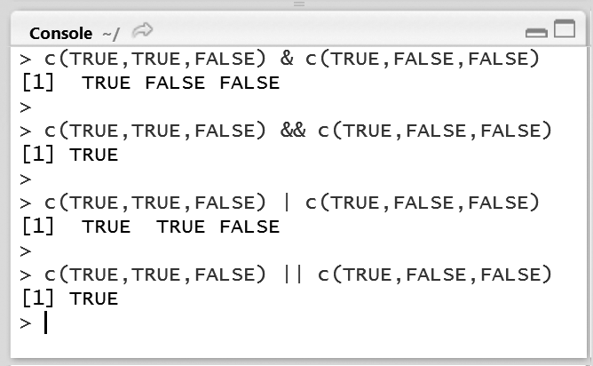
& Vs &&, | Vs ||
There are two versions of the AND and OR operators, namely the single operator and the double operator versions.
Fig. , as inputs, the first expression evaluates to a vector containing TRUE, FALSE, and FALSE. However if && is used, the result will be TRUE, since the && operator only examines the first element

Slide 11
conditional statements
If-else
If-else if-else

Slide 12
If-else statements
The syntax of an if statement contains a condition; if the condition evaluates to TRUE, the R code associated with the if statement is executed, the condition appears inside parentheses
Syntax:
if(condition) {
expression
}
if-else statement, the code associated with the else statement gets executed whenever the condition of the if statement is not satisfied.
Syntax:
if(condition) {
expression 1
}
else {
}
expression 2

Slide 13
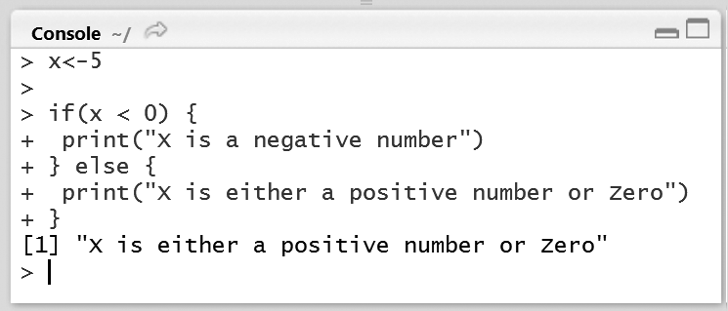
Figure shows an if condition that checks if X is less than zero.
It prints “X is either a positive number or zero” whenever the condition is not met.
Changing X to 5, the condition is not satisfied and prints the expression following the else statement.

Slide 14
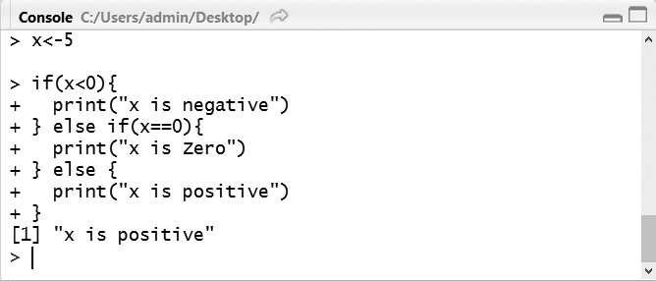
If-else if-else statements
The else if statement comes in between the if and else statements.
Syntax:
if(condition1) {
expression 1
}else if(condition2) {
expression 2
} else {expression 3
}

